Slide 1
Design of monopiles for multi-megawatt wind turbines at 50 m water depth
Authorship:
NJOMO W.
Anand Natarajan
Nikolay Dimitrov
Thomas Buhl

Slide 2
Problematic
Design difficulty |  | Water depth
 |  | shallow | deep
Turbine size | small | mild | medium
 | large | medium | high
Is the design of large diameter monopile placed at deep waters a straightforward extrapolation process from mild or medium designs?
Add Presentation Title in Footer via ”Insert”; ”Header & Footer”

Slide 3
Agenda
Design Environment
Medium Turbine
Large Turbine
Perturbation Analysis
Conclusion
Add Presentation Title in Footer via ”Insert”; ”Header & Footer”

Slide 4
Design Environment
Site Conditions: Metocean conditions and soil properties are presented in the paper.
Structure: DTU 10 MW RWT
Design Constraints:
Conflicting aspects: manufacturing, mass, wave loading
Natural frequencies
Maximum outer diameter 10.0 m
Minimum wall thickness
Maximum displacement at mudline and toe
Soil plastification
Computer software: aero-hydro-servo-elastic package, HAWC2
Add Presentation Title in Footer via ”Insert”; ”Header & Footer”

Slide 5
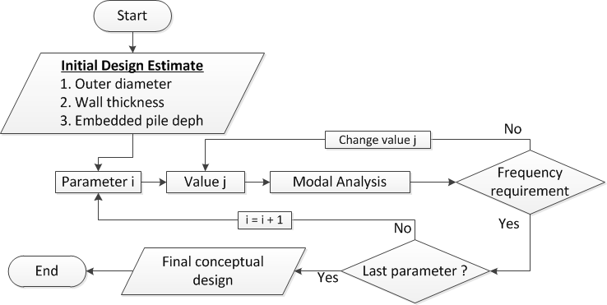
Geometry Design Process
Add Presentation Title in Footer via ”Insert”; ”Header & Footer”

Slide 6
Specificity of large diameter monopile
Structural stiffness distribution
Influence of wave diffraction
Soil-structure interaction
Add Presentation Title in Footer via ”Insert”; ”Header & Footer”

Slide 7
Geometry design
Add Presentation Title in Footer via ”Insert”; ”Header & Footer”

Slide 8
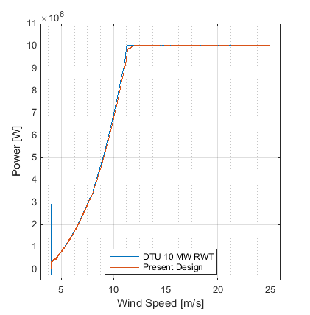
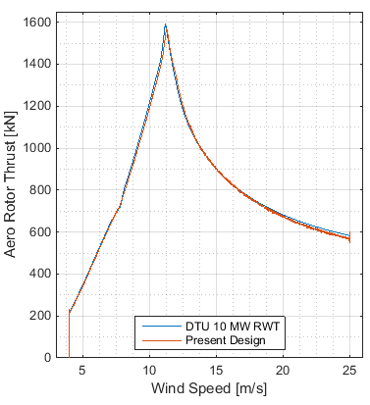
Global Performance
Power curve
Aero rotor thrust curve
Add Presentation Title in Footer via ”Insert”; ”Header & Footer”

Slide 9
Ultimate Limit state: Load cases and Stress vs strength
DLC 1.3: Ultimate loading resulting from extreme turbulence conditions with normal sea states.
DLC 6.2a: Ultimate loading resulting from turbulent extreme wind model with extreme sea states, coupled with loss of electrical power.
Add Presentation Title in Footer via ”Insert”; ”Header & Footer”

Slide 10
Ultimate Limit state: soil plasticization
Add Presentation Title in Footer via ”Insert”; ”Header & Footer”

Slide 11
Perturbation Analysis: Definition
Baseline – Toe as joint with restrained yaw and vertical motions. Contribution of axial skin friction. Wall thickness: 110 mm. Embedded depth: 30 m. Soil internal friction angle: 35⁰.
Perturbation A – Toe boundary condition. The pile tip is fixed, i.e. all degrees of freedom are restrained.
Perturbation B – Axial skin friction contribution. The contribution of skin friction to the pile axial equilibrium has been annihilated.
Perturbation C – Deeper pile. The embedded length of the pile has been changed from 30 m to 50 m.
Perturbation D – Thicker wall. The wall thickness has been increased to 150 mm.
Perturbation E – Soil friction angle. The soil around the pile is set denser; its internal angle has been improved from 35⁰ to 38⁰.
Add Presentation Title in Footer via ”Insert”; ”Header & Footer”

Slide 12
Perturbation Analysis: Dynamic stiffness
Add Presentation Title in Footer via ”Insert”; ”Header & Footer”

Slide 13
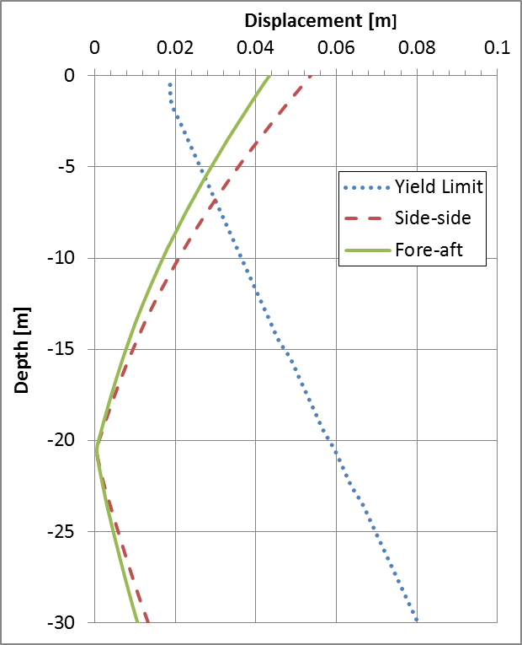
Perturbation Analysis: Deflection and plastic zone
Perturb. A, B, C, D
Perturb. E
Add Presentation Title in Footer via ”Insert”; ”Header & Footer”

Slide 14
Perturbation Analysis: Bill of material
Case | Baseline | A, B, E | C | D
Mass [t] | 2700 | 2700 | 3210 | 3666
Rel. diff. [%] | - | 0.00 | 18.87 | 35.78
Add Presentation Title in Footer via ”Insert”; ”Header & Footer”

Slide 15
Perturbation Analysis: Ultimate loads
At the interface
 | Fres [kN] | Fz [kN] | Mres [kNm] | Mz [kNm]
Baseline | 3500 | 13000 | 290000 | -38000
Pert. A | 0.0% | 0.0% | 3.4% | 36.8%
Pert. B | 0.0% | 0.0% | 0.0% | -234.2%
Pert. C | -2.9% | 7.7% | -3.4% | -415.8%
Pert. D | -2.9% | 0.0% | 3.4% | -218.4%
Pert. E | 2.9% | 0.0% | 3.4% | 36.8%
At the mudline
 | Fres [kN] | Fz [kN] | Mres [kNm] | Mz [kNm]
Baseline | 11000 | 40000 | 730000 | -38000
Pert. A | 0.0% | 0.0% | 2.7% | 39.5%
Pert. B | 9.1% | 0.0% | 0.0% | -236.8%
Pert. C | 9.1% | 0.0% | 8.2% | -442.1%
Pert. D | 0.0% | 17.5% | 2.7% | -221.1%
Pert. E | 9.1% | 0.0% | 5.5% | 39.5%
Add Presentation Title in Footer via ”Insert”; ”Header & Footer”

Slide 16
Discussion
Similar dynamic stiffness but different lateral deformations
Increase wall thickness is inefficient
Axial skin friction is non-influential
Fixed toe may be misrepresentative
Add Presentation Title in Footer via ”Insert”; ”Header & Footer”

Slide 17
Conclusion
Distribute flexural stiffness along the whole length – Tower Change.
Start with the traditional procedure, and progressively adjust the design parameters.
Target the centre of the soft-stiff range – resulting lateral deformations will be moderate.
Mind the soil status – consider monopile deepening.
Add Presentation Title in Footer via ”Insert”; ”Header & Footer”

Slide 18
THANK YOU FOR YOUR ATTENTION
Add Presentation Title in Footer via ”Insert”; ”Header & Footer”

Slide 19
Medium size turbine
Initial design estimate: Final design:
Outer diameter 8.0 m 8.0 m
Wall thickness 100 mm 120 mm
Embedded part 50.0 m 30.0 m
Wall thickness [mm] | Eigen frequencies [Hz]
 | Mode 1 | Mode 2 | Mode 3 | Mode 4
90 | 0.224 | 0.227 | 0.544 | 0.584
100 | 0.229 | 0.232 | 0.545 | 0.584
120 | 0.238 | 0.242 | 0.546 | 0.585
Embedded length [m] | Eigen frequencies [Hz]
 | Mode 1 | Mode 2 | Mode 3 | Mode 4
25.00 | 0.218 | 0.221 | 0.548 | 0.580
30.00 | 0.227 | 0.230 | 0.548 | 0.587
50.00 | 0.238 | 0.242 | 0.546 | 0.585
Add Presentation Title in Footer via ”Insert”; ”Header & Footer”

Slide 20
Geometry design
Initial design estimate: Final design:
Outer diameter 10.0 m 9.5 m
Wall thickness 120 mm 110 mm
Embedded part 30.0 m 30.0 m
Outer diameter [m] | Eigen frequencies [Hz]
 | Mode 1 | Mode 2 | Mode 3 | Mode 4
9.50 | 0.218 | 0.267 | 0.548 | 0.564
10.00 | 0.225 | 0.227 | 0.549 | 0.565
Tower type and mass [t] | Eigen frequencies [Hz]
 | Mode 1 | Mode 2 | Mode 3 | Mode 4
A: 426.293 | 0.218 | 0.267 | 0.548 | 0.564
B: 511.131 | 0.239 | 0.241 | 0.563 | 0.576
Wall thickness [mm] | Eigen frequencies [Hz]
 | Mode 1 | Mode 2 | Mode 3 | Mode 4
110 | 0.234 | 0.236 | 0.563 | 0.575
120 | 0.239 | 0.241 | 0.563 | 0.576
Add Presentation Title in Footer via ”Insert”; ”Header & Footer”

Slide 21
Conclusion
Initial Design Estimate
Stress
Frequency requirement
Ultimate limit state
Deformation
Soil plastification
Add Presentation Title in Footer via ”Insert”; ”Header & Footer”

Slide 22
Add Presentation Title in Footer via ”Insert”; ”Header & Footer”

